Slide 1

Flatiron Module 1 Project: King County House Prices

Slide 2

Hello!
My name is Kiarash Ahmadi. I’m an aspiring Data Scientist with Flatiron Academy. I am also pursuing a Master’s in Computational Science & Engineering at Georgia Tech.

Slide 3
Project Background
King County Housing Sales from 2014-2015
Model predicts housing prices based off different features
Clean, Explore, and Model with Multi-Linear Regression

Slide 4
Questions to be answered
1. How does the quality of a house affect prices?
How can I quantify quality from the variables within the dataset?
2. What is a view’s impact on house prices?
It’s widely assumed that a view generally leads to higher housing prices.
3. Does location matter the most? If not what?
It was initially suspected that location affects housing prices the most.

Slide 5
How do I quantify quality?
Grades 1-6: Below Average
Poor construction
Simple Design
Older
Barely meets or fails to meet minimum building standards
Grades 7-9: Average
Average to just above average design and construction
Better materials in interior and exterior finish work
Grades 10-13: Above Average
High quality features and materials
Custom, detailed design
More luxurious options

Slide 6
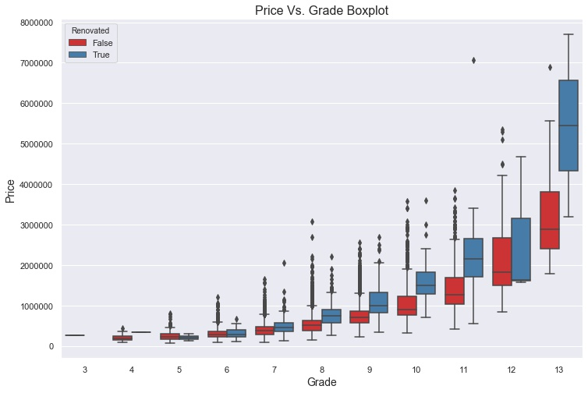
How does the quality of a house affect prices?
Model indicates that a 10% increase in an above average grade leads to a 7.66% increase in price.
Renovated homes tend to have higher values when compared to their peers

Slide 7
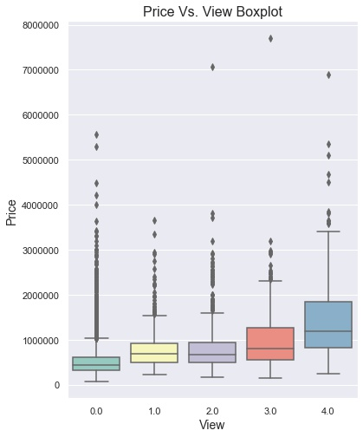
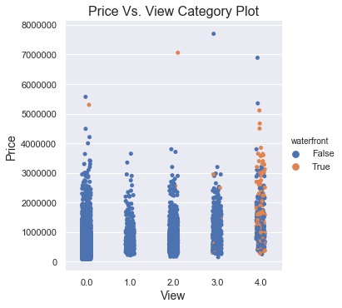
What is a view’s impact on house prices?
10% increase in views 3-4 leads to 7.65% increase in price
A 10% increase in views 0-2 causes a 3.52% increase in price.
Notes:
Mention waterfront 6.09

Slide 8
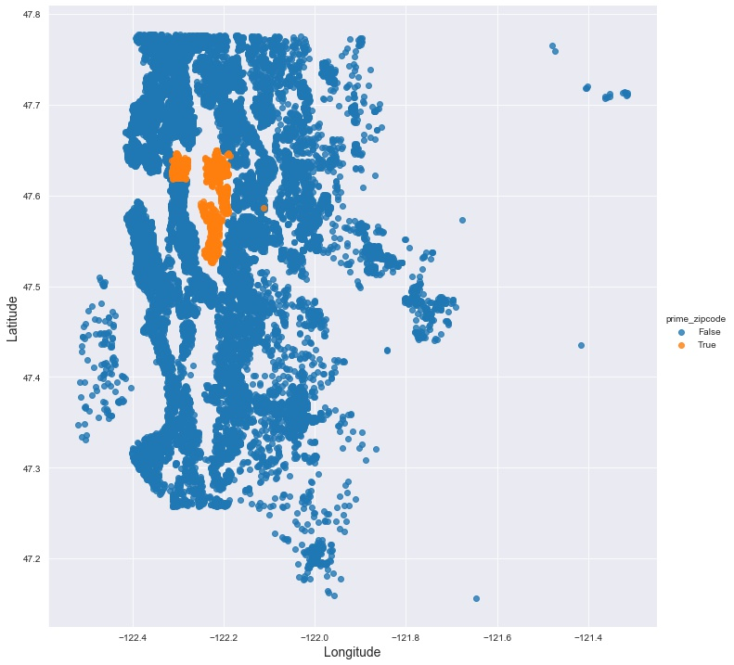
Does Location Matter the Most?
Determined the top 4 zip codes and their locations
Found distance of each house from average coordinates of houses in the top 4 zip codes

Slide 9
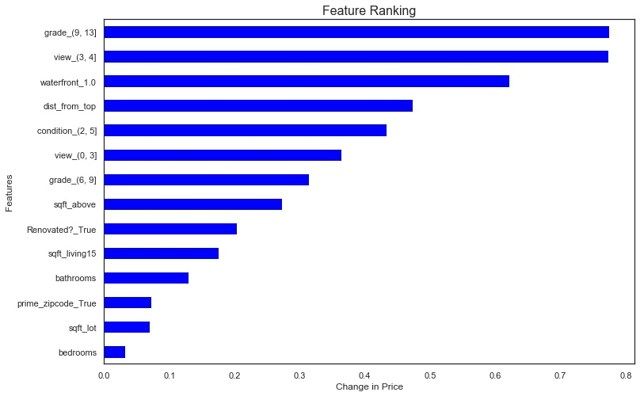
If Not, What does?
A 10% increase in distance from the top zip codes causes a 4.61% decrease in price
Grades 9-13 cause the most change in price
Square footage is less impactful than expected

Slide 10

Recommendations
Quality
Causes the most change in price when increased
View
Also has a significant impact on price
Location
Being 10% closer to top zip codes leads to 4.86% change in price
Future Work
Develop Scores
Create a quality and view score using the view, grade, renovation, and waterfront predictor variables
Quantifying Location
Improve how the model measured a good location beyond just its distance from the top zip codes.
Incorporate Interactions
Introduce new variables that account for the interactions among predictors
Notes:
2.31 quality
5.89 view

Slide 11

Thanks!
Any questions?
You can find me at:
mkiah09@gmail.com

